Slide 1
Common skin disease classification
Using deep learning

Slide 2
Team Info
Pranay Reddy Mankala - 700742423
Nikhil Vemula - 700757744
Vivek Kothapally - 700756641
Siva pavan phani kumar jasti - 700746363

Slide 3
Role/Responsibilities and Contribution in project
Name | Role | Responsibility | Contribution
Nikhil Vemula Vivek Kothapally | Data Collector | Responsible for gathering Dermnet and skinnet dataset | Data collection labelling and annotating
Pranay Reddy Mankala Nikhil Vemula | Model Developer | Responsible for models development(InceptionV3 and EfficientNet) for skin disease classification. | Building and training the models
Siva pavan phani kumar jasti Vivek Kothapally | Technical Researcher | Responsible for report detailing | Creating report which includes Describes the implementation details
Pranay Reddy Mankala Siva pavan phani kumar jasti | Project Coordination and Management | Responsible for coordinating team members | Team coordination and project flow check

Slide 4
Motivation
In this study, we aim to investigate the efficacy of transfer learning models, specifically InceptionV3 and EfficientNet, in predicting five categories of common skin diseases: Acne and Rosacea, vitiligo, Tinea Ringworm Candidiasis and other Fungal Infections, Melanoma Skin Cancer Nevi and Moles, and Eczema. By evaluating the performance of these models, we seek to contribute to the development of more effective diagnostic tools for dermatological conditions, ultimately improving patient outcomes and enhancing the delivery of dermatological care.

Slide 5
Objectives
1.Dataset Analysis: Analyzing two datasets, Dermnet and Skinnet.
2.Building transfer learning models: Building two transfer
3.Model Optimization: Exploring techniques for optimising the transfer learning models to improve prediction accuracy and reduce false positives/negatives
4.Evaluate Transfer Learning Models: Assess the effectiveness of transfer learning models, specifically InceptionV3 and EfficientNet.
5.Performance Comparison: Compare the performance of InceptionV3 and EfficientNet models in terms of accuracy, precision, recall, and F1-score for each skin disease category.

Slide 6
Related work
Skin diseases, like melanoma, are on the rise, making early detection and classification vital for timely treatment. Manual diagnosis is slow and error-prone, especially with more cases emerging. In this proposed framework CNN model with ensemble models are proposed. For the experimental analysis ISIC 2018 dataset is used. In the results analysis there is evidence of an 11 percent increase of accuracy on existing models. This model can be deployed to use in real world scenarios due to better generalization capability [1].
The methodology of the proposed network involves two steps: in the first step a Full Resolution Convolutional neural Network is used to segment the outer corners of the lesion region and in the second step involves the classification of skin lesions. For the classification task ResNet50 is used.The results analysis is divided into two sections one is evaluating the performance of full resolution convolutional neural network and the other one is classification accuracy. To evaluate the segmentation process Jaccard similarity metric used. The overall accuracy of the model is 94.03 percent [2].
In skin lesion analysis only classifying the images is not sufficient. To prescribe further treatment the affected area must be analysed. To accomplish this lesion needs to be segmented. In this paper we are proposing the ensemble models for segmentation of images. The architectures include VGG19-UNet, DeeplabV3+. The experimental analysis is conducted on ISIC 2018 dataset it contains 2594 dermoscopic images.Our proposed model achieved an accuracy of 93.6 across all classifications, with an average Jaccard Index of 0.815 and a dice coefficient of 0.887 when evaluated on the testing dataset [3].

Slide 7
Problem Statement
Acne and Rosacea, vitiligo, Tinea Ringworm Candidiasis and other Fungal Infections, Melanoma Skin Cancer Nevi and Moles, and Eczema. Addressing common skin conditions holds significant public health implications, as they contribute to healthcare costs and resource allocation. Common skin conditions such as acne, rosacea, vitiligo, fungal infections, moles, and eczema can occur due to various factors, including genetics, environmental influences, lifestyle factors, and immune system responses. Though these diseases are common sometimes it is difficult to identify manually. An automated skin disease classifier helps in diagnosis.

Slide 8
Proposed Solution
This study investigates the efficiency of transfer learning models in predicting 5 categories of common skin diseases Acne and Rosacea, vitiligo, Tinea Ringworm Candidiasis and other Fungal Infections, Melanoma Skin Cancer Nevi and Moles, and Eczema. Two transfer learning models InceptionV3 and EfficentNet are used to classify the images. In the results analysis, InceptionV3 out performed the Efficient Net model.

Slide 9
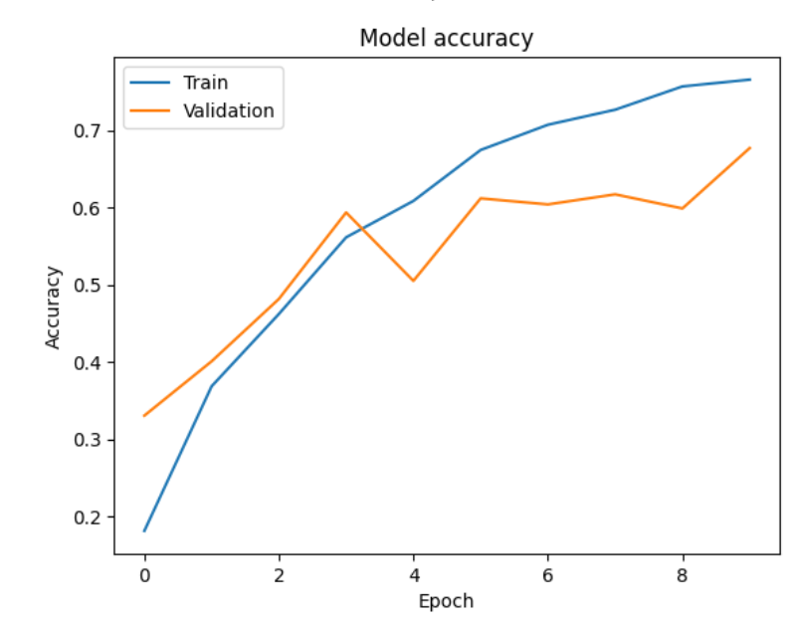
Results/Simulations
Figure 1. Represents accuracy of the model.InceptionV3 model is trained for 10 epochs and accuracy is recorded for each epoch and plotted the accuracy.
Model achieved 75 % on training samples and 65% on validation samples
Figure 1. InceptionV3 model performance

Slide 10
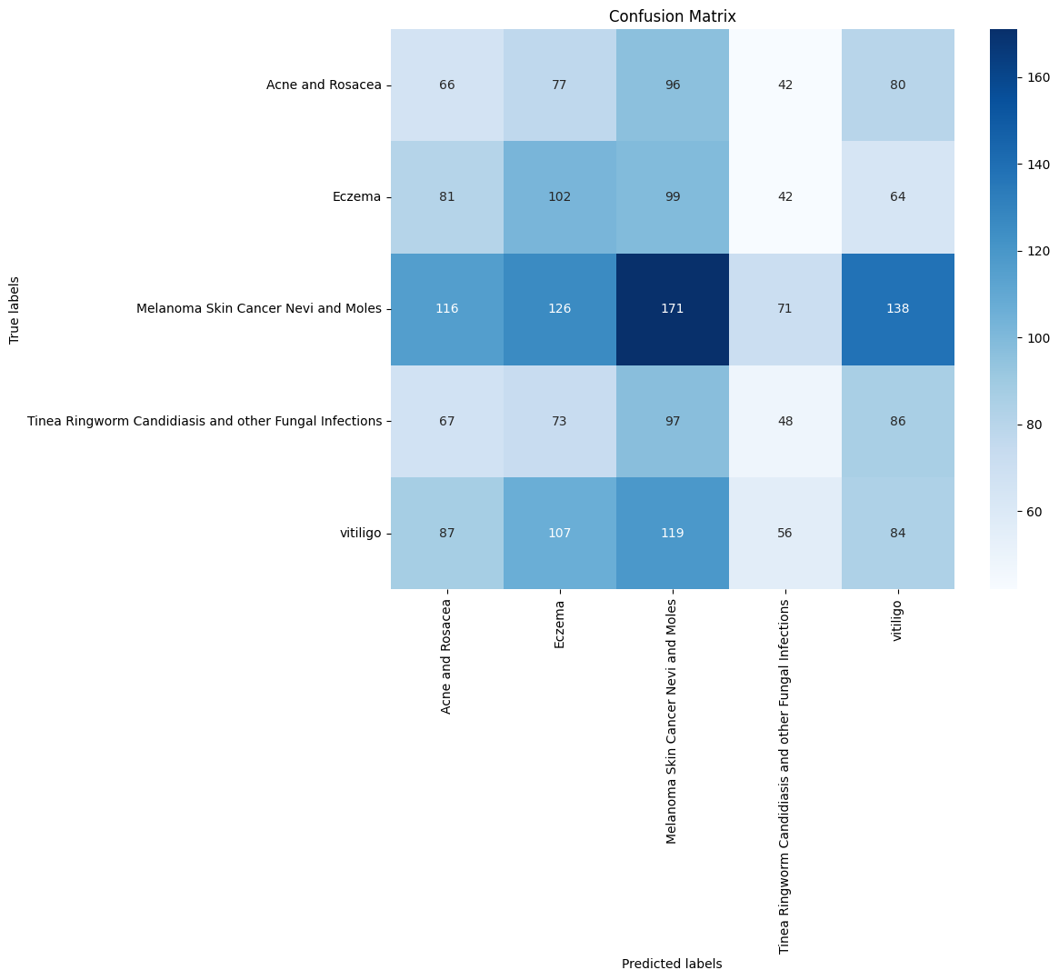
Results/Simulations
Figure 2. Represents confusion matrix of the model.
Figure 1. Confusion matrix for InceptionV3 model

Slide 11
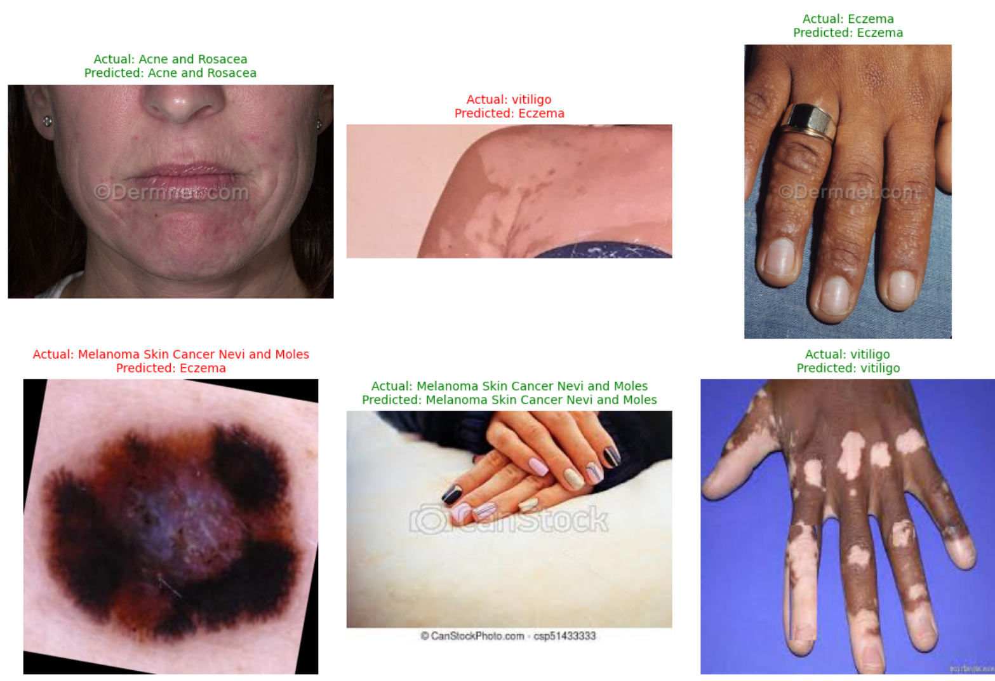
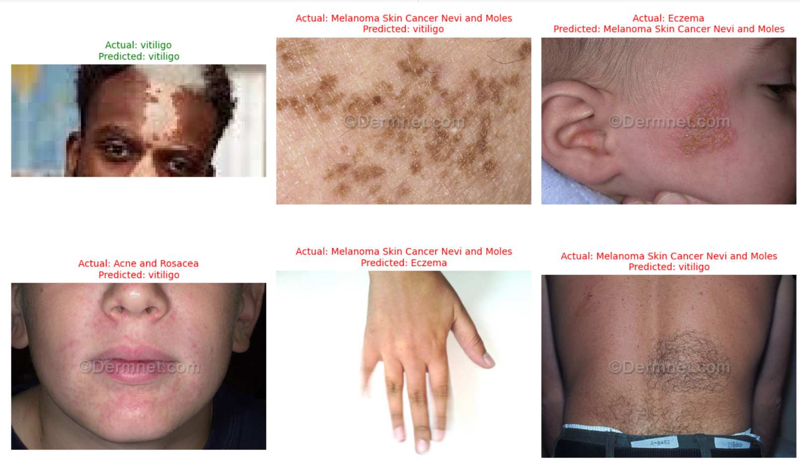
Results/Simulations
Figure.3. Sample predictions
Figure.3. Represents sample predictions made by the model correct and incorrect classifications

Slide 12
References
[1]. Mohammed A. Al-masni, Mugahed A. Al-antari, Hye Min Park, Na Hyeon Park, and Tae-Seong Kim. A deep learning model integrating frcn and residual convolutional networks for skin lesion segmentation and classification. In 2019 IEEE Eurasia Conference on Biomedical Engineering, Healthcare and Sustainability (ECBIOS), pages 95–98, 2019.
[2] Redha Ali, Russell C. Hardie, Barath Narayanan Narayanan, and Supun De Silva. Deep learning ensemble methods for skin lesion analysis towards melanoma detection. In 2019 IEEE National Aerospace and Electronics Conference (NAECON), pages 311–316, 2019.
[3] Zhipeng Deng, Yuqiao Yang, Kenji Suzuki, and Ze Jin. Fedal: An federated active learning framework for efficient labeling in skin lesion analysis. In 2022 IEEE International Conference on Systems, Man, and Cybernetics (SMC), pages 1554–1559, 2022.

